Slide 1

Introduction to Portfolio Management & Exchange Traded Derivatives
MANG 6142 Lecture 1
Di Luo
d.luo@soton.ac.uk

Slide 2


Slide 3
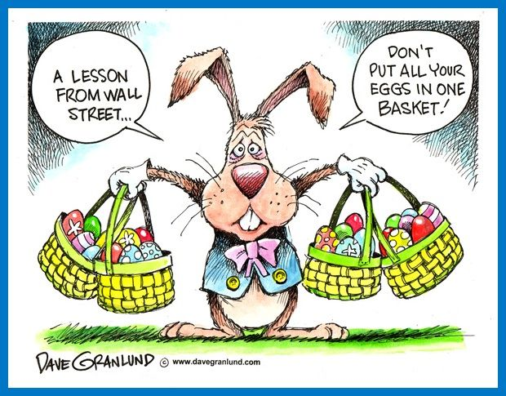

Slide 4


Slide 5
Critical Concepts
Opportunity Set
Indifference Curves
Financial Securities
Financial Markets
Trading Mechanics

Slide 6
Part A: The Economic Theory of Choice
The Opportunity Set
The Indifference Curves
The Solution
An Example: Determining Equilibrium Interest Rates

Slide 7



THE ECONOMIC THEORY OF CHOICE: AN ILLUSTRATION UNDER CERTAINTY
Choice 1
Choice 2
Period 1
Period 2
Nothing

Slide 8
Numerical example
Consider an investor who will receive with certainty an income of $10,000 in each of two years. Assume that the only investment available is a savings account yielding 5% per year. In addition, the investor can borrow money at a 5% rate.

Slide 9
Cosume nothing at time 1
10,000*(1+0.05)=10,500
10,500+10,000=20,500

Slide 10
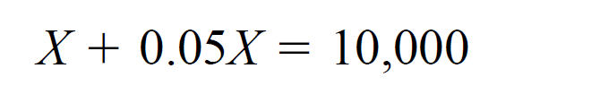
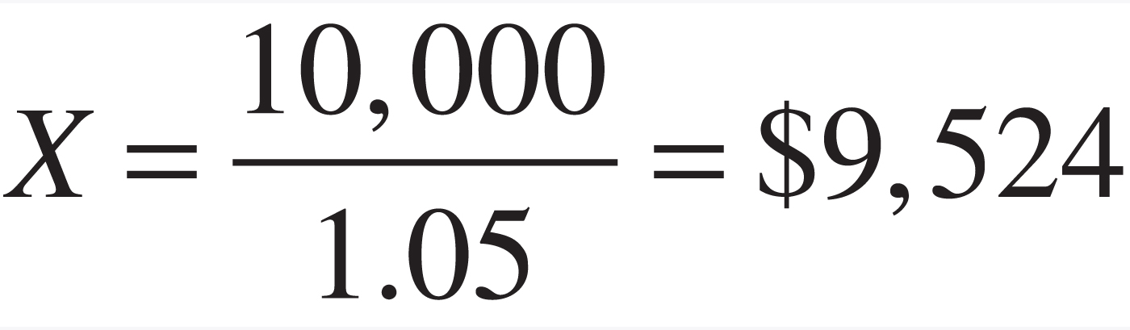
Consume all at time 1
The max amount borrowed X

Slide 11
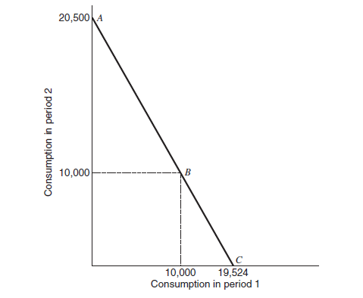
Figure 1.1 The investor’s opportunity set

Slide 12
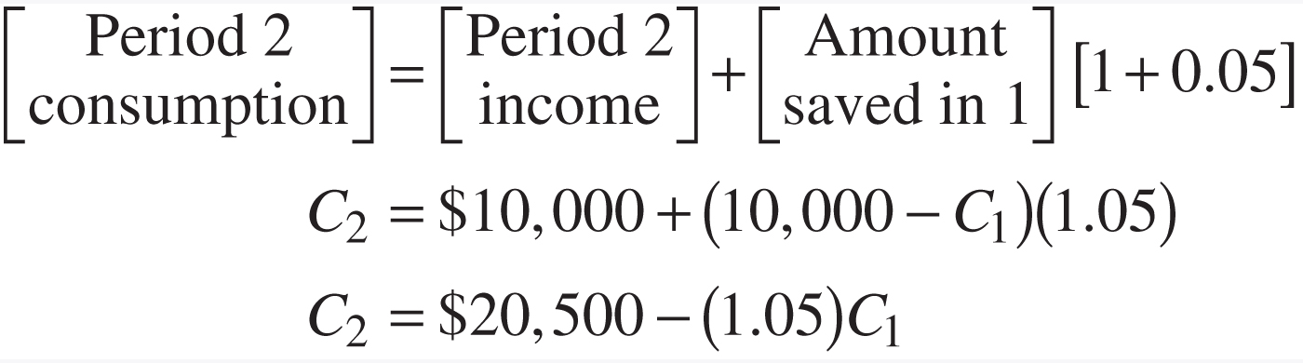
Equn_p5b

Slide 13


Indifference Curves

Slide 14
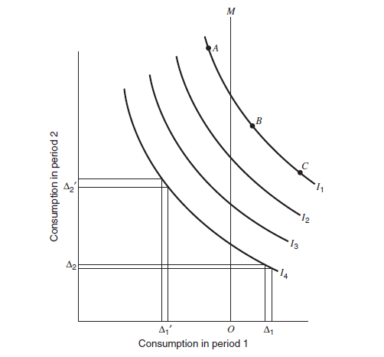
Figure 1.2 Indifference curves.

Slide 15
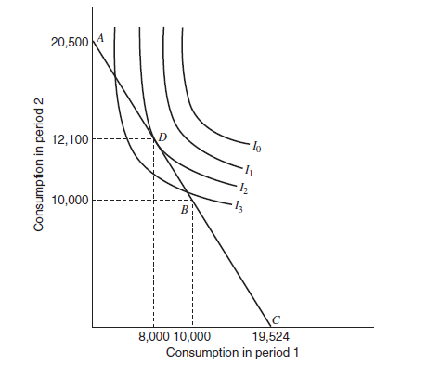
Figure 1.3 Investor equilibrium.

Slide 16
Conclusion
We need two components to reach a solution:
  A representation of the choices available to the investor—called the opportunity set
  A representation of the investor’s tastes or preferences—called indifference or utility curves

Slide 17
Multiple Assets and Risk
If everyone knew with certainty the returns on all assets, then the framework just presented could easily be extended to multiple assets.

Slide 18
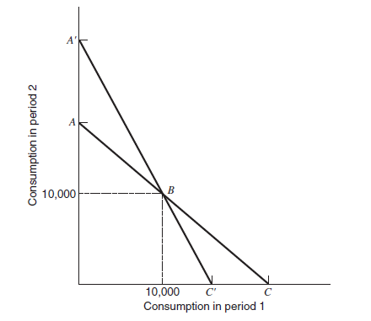
Figure 1.4 Investor’s opportunity set with several alternatives.

Slide 19
Part B: Financial Securities
Types of Marketable Financial Securities
The Return Characteristics of Alternative Security Types
Stock Market Indexes
Bond Market Indexes
Conclusion

Slide 20
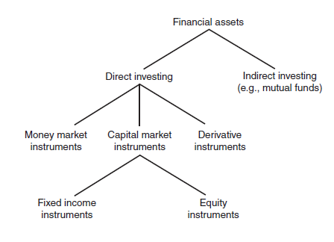
Many ways to categorize financial securities

Slide 21
Types of Marketable Financial Securities
Money Market Securities
  Treasury Bills
  Other Short-Term Instruments
  The London Interbank Offered Rate (LIBOR)

Slide 22
Types of Marketable Financial Securities (cont.)
Capital Market Securities
  Fixed Income Securities
    Treasury Notes and Bonds
    Municipal Bonds
    Corporate Bonds
  Not-So-Fixed Income Securities
    Preferred Stock

Slide 23
Types of Marketable Financial Securities (cont.)
Capital Market Securities (cont.)
  Asset-Backed Securities
    Mortgage-Backed Securities
  Common Stock (Equity)
Derivative Instruments

Slide 24
Stock Market Indexes
The oldest continuously quoted index of stock price performance in the U.S. is the Dow Jones Industrial Average Index (DJIA).
  Price-weighted average of 30 large “blue chip” stocks.
Next most popular U.S. stock market index is the Standard and Poor’s Composite 500 stock index (S&P 500)
NYSE/AMEX/NASDAQ value-weighted returns

Slide 25
Bond Market Indexes
The major bond indexes are total return indexes.
They include interest payments as well as capital gains.
Some best known bond indexes are constructed by Barclays, FTSE, et al.

Slide 26
Part C: Financial Markets
Trading Mechanics
Markets
Trade Types and Costs
Conclusion

Slide 27
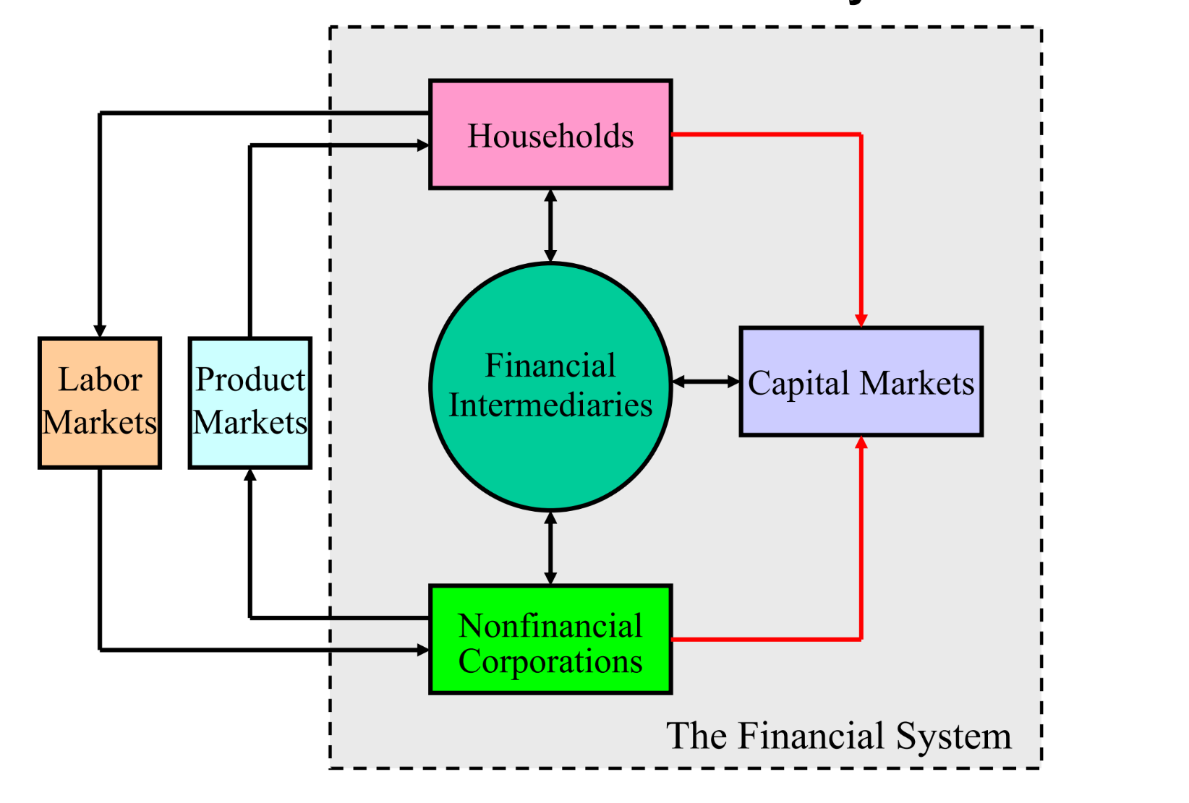
A Flow Model of the Economy

Slide 28
Segments of Financial Markets
Direct Finance
  Borrowers borrow directly from lenders in financial markets by selling financial instruments which are claims on the borrower’s future income or assets
Indirect Finance
  Borrowers borrow indirectly from lenders via financial intermediaries (established to source both loanable funds and loan opportunities) by issuing financial instruments which are claims on the borrower’s future income or assets

Slide 29
FINANCIAL MARKETS
Markets in which funds are transferred from people who have an excess of available funds to people who have a shortage of funds.

Slide 30
Why Study Financial Markets?
The Bond Market
The Stock Market

Slide 31
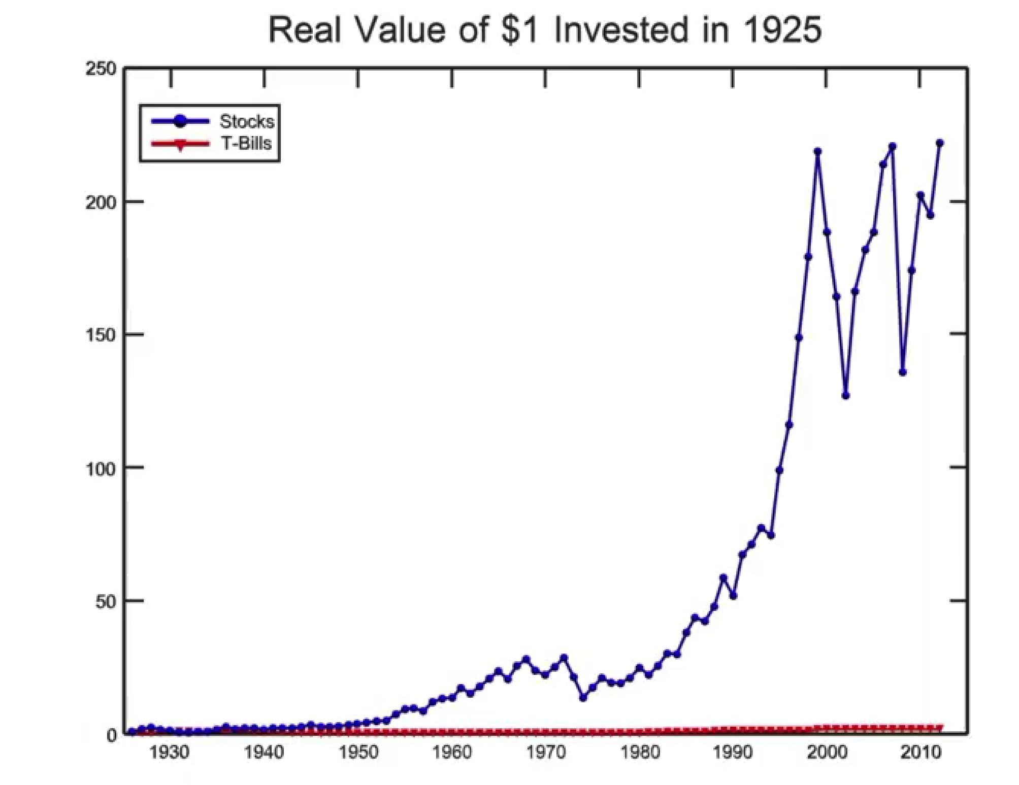

Slide 32
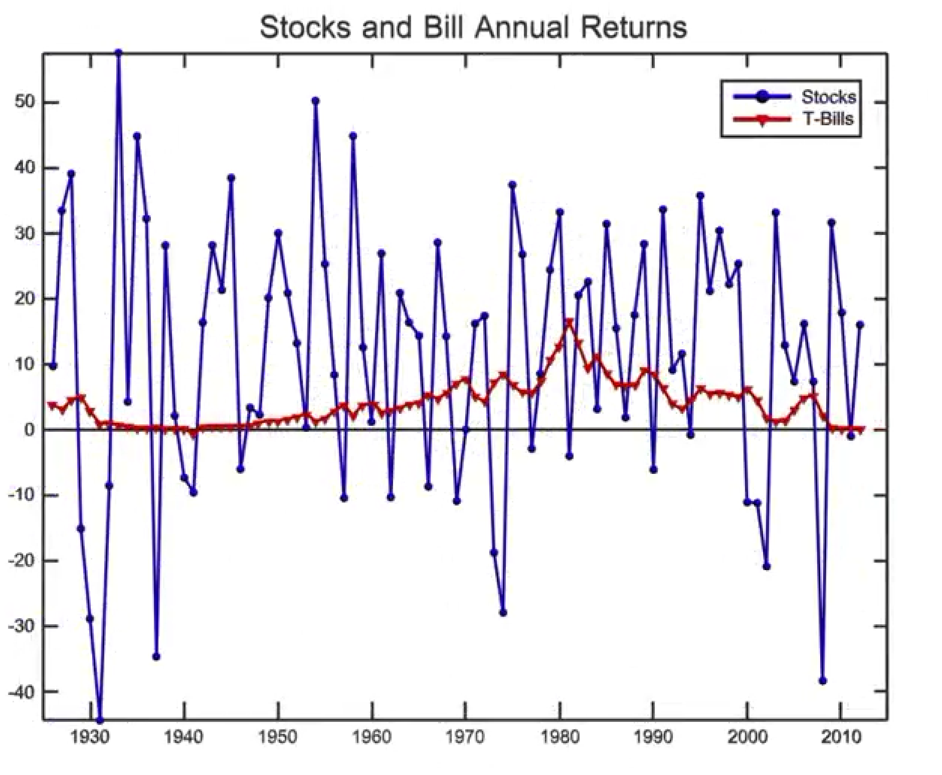

Slide 33
Know the Data
“The annual U.S. equity premium for 1926 to 2013 is roughly 8% and the annual volatility is about 20%. The autocorrelations in equity returns are small and can often be ignored.”
(http://www.dimensional.com/famafrench/essays/things-ive-learned-from-gene.aspx)

Slide 34
Importance of Financial Markets
This is important. For example, if you save $1,000, but there are no financial markets, then you can earn no return on this – might as well put the money under your mattress.
However, if a carpenter could use that money to buy a new saw (increasing her productivity), then she’d be willing to pay you some interest for the use of the funds.

Slide 35
TRADING MECHANICS
An individual wishing to buy or sell a security would first establish an account and then submit (by phone or computer) an order.
the security the investor wishes to trade
the direction of the order (buy or sell)
the order size, e.g., 400 shares of stock
whether the order is market or limit

Slide 36
Market Orders: a market order directs the broker to buy or sell the security at the best available price.
Limit Orders: the customer states a price that specifies the worst acceptable terms of trades.
Short Selling: investors can sell securities they do not own.
Stop Orders: activated only when the price of the stock reaches or passes through a predetermined limit.

Slide 37
Limit Order vs. Stop Order
Limit Order
Stop Order
Trade at a price equal to or better than a certain price. For buy orders, buy at $X or lower. For sell orders, sell at $X or higher.
Try to take advantage of a certain target price
Trade if price moves beyond the desirable target. For buy orders, buy if price climbs above $X.For sell orders, sell if price falls below $X.
Limit losses

Slide 38
Markets
Characteristics of Markets
Major Markets (secondary markets)
  Stock Markets
  Bond Markets
Primary Markets
    Government Bonds
    Corporate Issues
Clearing Procedures

Slide 39
Various types of financial markets
1. Primary markets vs Secondary markets
2. Call markets (intervals) vs Continuous markets
3. Dealer markets (own stocks) vs Broker markets (agent)
4. Humans vs done electronically

Slide 40
There are some characteristics for a desirable market:
    Market information should be promptly and accurately available to investors.
    Trading costs should be low.
    Share prices should reflect all available information about the shares.
    The market should be liquid.

Slide 41
Thank You Very Much!

